Slide 1
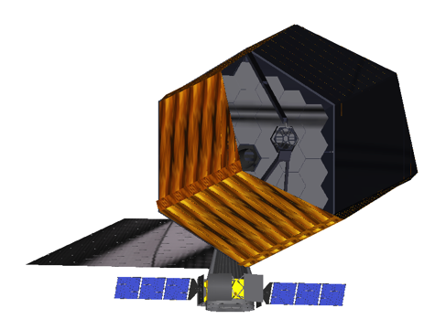
Cosmic Origins & Living Worlds – ESA Science Ideas Submission
Martin Barstow (with thanks to collaborators, HDST & LUVOIR teams)

Slide 2
Introduction
Background
NUVA
ESA call for ideas
Response

Slide 3
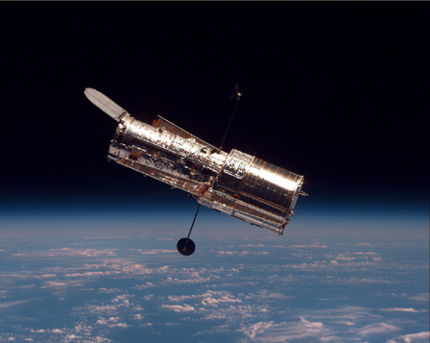
UV Astronomy Problem
Access to UV has been continuous since IUE (1978)
HST has enormous capability…
  STIS, COS, WFC3
…but inevitably limited life
  Now 25+ years old
No new UV-capable observatory planned

Slide 4
European Response
Development of involvement in World Space Observatory
  Launch date remains uncertain
UV section of OPTICON network - 2003
Network for UV Astronomy – 2008
  Led by Ana-Ines Gomez de Castro
Coordinated response to ESA L mission call
  European UV Observatory (EUVO) submitted

Slide 5

The Network for UltraViolet Astronomy
The Network for UltraViolet Astrophysics (NUVA) is a pan-european network set-up to identify the needs of the astronomical community in the UV domain and eventually propose actions to structure it around new projects
ACTIVITIES
Science
Technology
Missions
Workshops
Publication series
ESA framework
Bilateral programs
International programs
Working Group on UV Astronomy
DIVISION B
Facilities, Technologies & Data Science

Slide 6
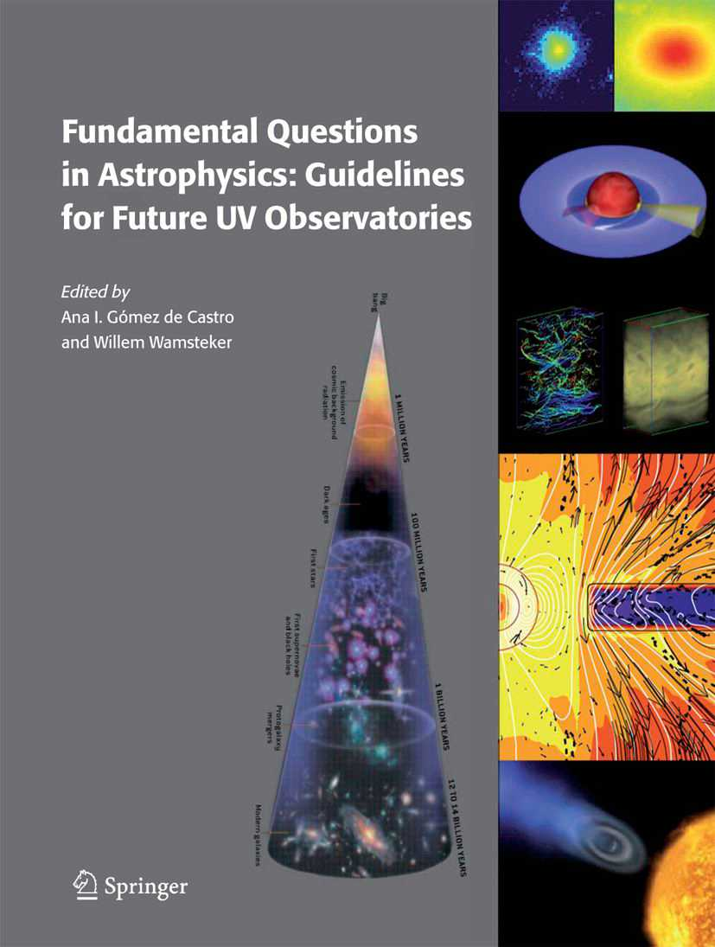
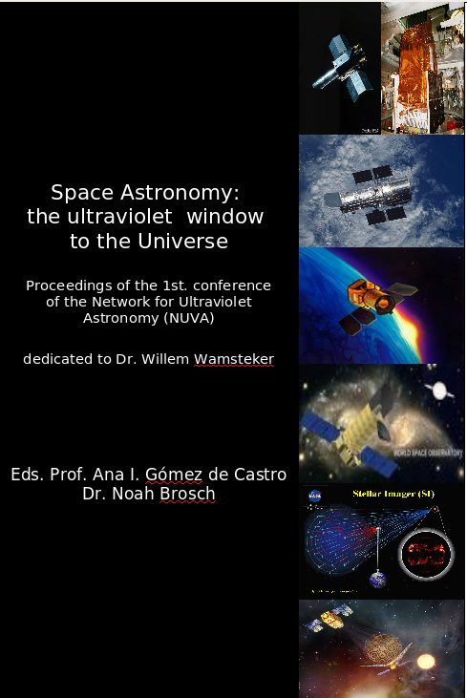
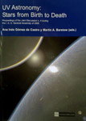
www.nuva.eu
UV SCIENCE: BROAD RANGE OF INTEREST
NUVA WORKSHOPS
The NUVA publication series:
Challenges in UV Astronomy. Eds. Ana I. Gómez de Castro, Beatriz Barbuy, Jorge Melnick, Noah Brosch & Mikhail Sachkov, 2014, Astrophysics and Space Science, Special Volume, 354
UV Astronomy 2011. Eds. Boris Shustov, Ana I. Gómez de Castro, Mikhail Sachkov & Michael Dopita, 2012, Ed Springer Science+Business Media B.V., ISBN 978-94-007-2572-0
Space Astronomy: the UV window to the Universe. Eds. Ana I Gómez de Castro & Noah Brosch, 2009,
UV Astronomy: stars from birth to death. Eds. Ana I. Gómez de Castro & Martin A. Barstow, 2007, Ed. Universidad Complutense, ISBN: 978-84-7491-852-6
Fundamental Questions in Astrophysics: Guidelines for future UV observations. Eds. Ana I Gómez de Castro & Willem Wamsteker, 2006, Ed. Springer, ISBN: 1-4020-4838-6, 1-4020-4839-4

Slide 7
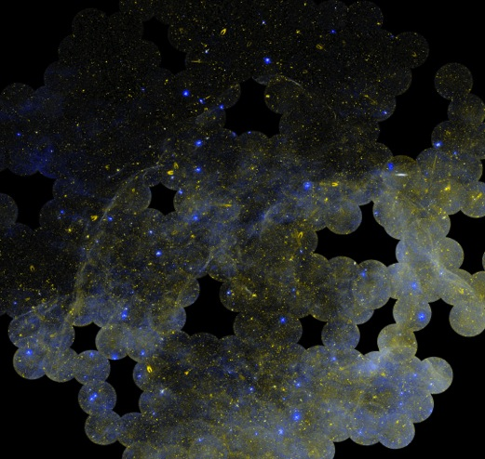
EUROPEAN ULTRAVIOLET-VISIBLE OBSERVATORY
Thierry Appourchaux – IAS France; Martin Barstow – University of Leicester UK; Mathieu Barthelemy - IPAG, France; Fréderic Baudin – IAS, France; Stefano Benetti – OAPD- INAF, Italy; Pere Blay - Universidad de Valencia, Spain; Noah Brosch - Tel Aviv University, Israel; Enma Bunce - University of Leicester, UK; Domitilla de Martino – OAC-INAF, Italy; Ana Ines Gomez de Castro –Universidad Complutense de Madrid, Spain; Jean-Michel Deharveng – Observatoire Astronomique Marseille-Provence, France; Roger Ferlet - Institute d'Astrophysique de Paris, France; Kevin France - University of Colorado, USA; Miriam García – IAC, Spain; Boris Gaensicke -University of Warwick, UK; Cecile Gry - Observatoire Astronomique Marseille-Provence, France; Lynne Hillenbrand – Caltech, USA; Eric Josselin - University of Montpellier, France; Carolina Kehrig – Instituto de Astrofísica de Andalucía, Spain; Laurent Lamy - LESIA, France; Jon Lapington – University of Leicester, UK; Alain Lecavelier des Etangs – Institute d'Astrophysique de Paris, France; Frank LePetit – Observatoire Paris-Meudom, France; Javier Lopez Santiago - Universidad Complutense de Madrid, Spain; Bruno Milliard- Observatoire Astronomique Marseille-Provence, France; Richard Monier - Université de Nice, France; Giampiero Naletto – University of Padova, Italy;Yael Nazé - Liège University, Belgium; Coralie Neiner - LESIA, France; Jonathan Nichols – University of Leicester, UK
Marina Orio – OAPD-INAF, Italy; Isabella Pagano – OACT-INAF, Italy; Céline Peroux – Observatoire Astronomique Marseille-Provence, France; Gregor Rauw – University of Liège, Belgium; Steven Shore – University of Pisa, Italy ; Marco Spaans - Kaptein Astronomical Institute, The Netherlands ; Gagik Tovmassian - Instit. Astr. Sede Ensenada-UNAM, Mexico; Asif ud-Doula - Penn State University, USA; José Vilchez – Instituto de Astrofísica de Andalucía, Spain and www.nuva.eu
“Building galaxies, stars, planets
and the ingredients for life between
the stars”
Notes:
Solar system – temporal phenomena from ~s to tens of yr timescales
Short term orbiter missions cannot capture long time variations or observe many different bodies
The key unique selling point for EUVO is angular resolution

Slide 8
ESA Call for Science Ideas
LOI submission deadline – May 9th 2016
Deadline for proposals – September 14th
Selection in December (!) of a “limited number of ideas” – process on-going
European working group created to respond
  Building on AURA HDST 2015 report (www.hdstvision.org)
  Aligning with US LUVOIR activity
“Cosmic Origins and the Search for Living Worlds”

Slide 9
Cosmic Origins & the Search for Living Worlds
Lead proposer: Martin Barstow – University of Leicester
  Core Team: S. Aigrain, J. Barstow, M. Barthelemy, B. Biller, A. Bonanos, C. Bonoli, L. Buchhave, S. Casewell, C. Charbonnel, S. Charlot, R. Davies, N. Devaney, C. Evans, M. Ferrari, A. Ferguson, A. Fontana, L. Fossatti, B. Gänsicke, M. Garcia, A. Gomez de Castro, D. Gouliermis, T. Henning, L. Lamy, S. Larsen, C. Lintott, C. Knigge, C. Neiner, L. Rossi, S. Rugheimer, D. Sing, C. Snodgrass, D. Stam, E. Tolstoy, M. Tosi
Large UVOIR telescope - target exoplanet studies as principal scientific goal:
  Carry out high contrast imaging survey of nearby stars to search for planets within habitable zones
  Characterise planets detected, determine masses/radii
  Search for habitability indicators & signs of an environment modified by the presence of life
Significant additional scientific contributions

Slide 10
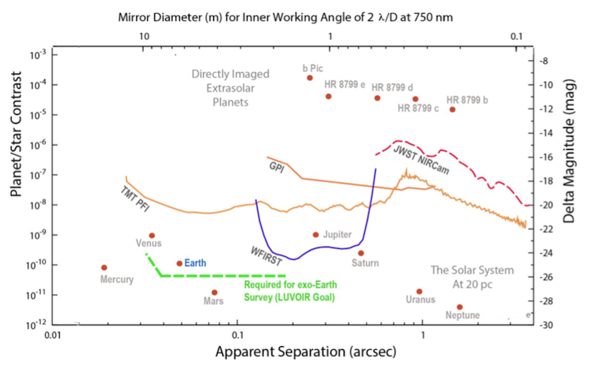
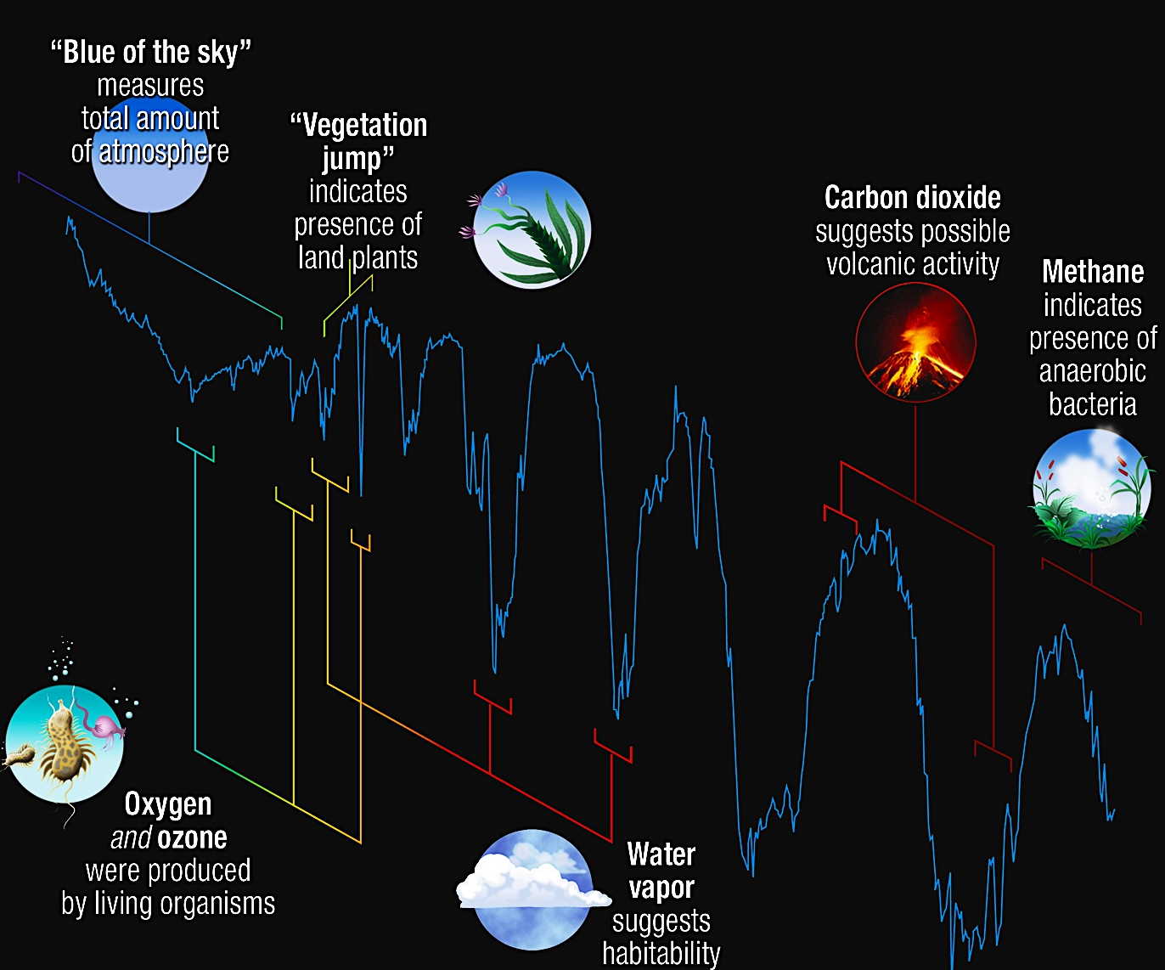
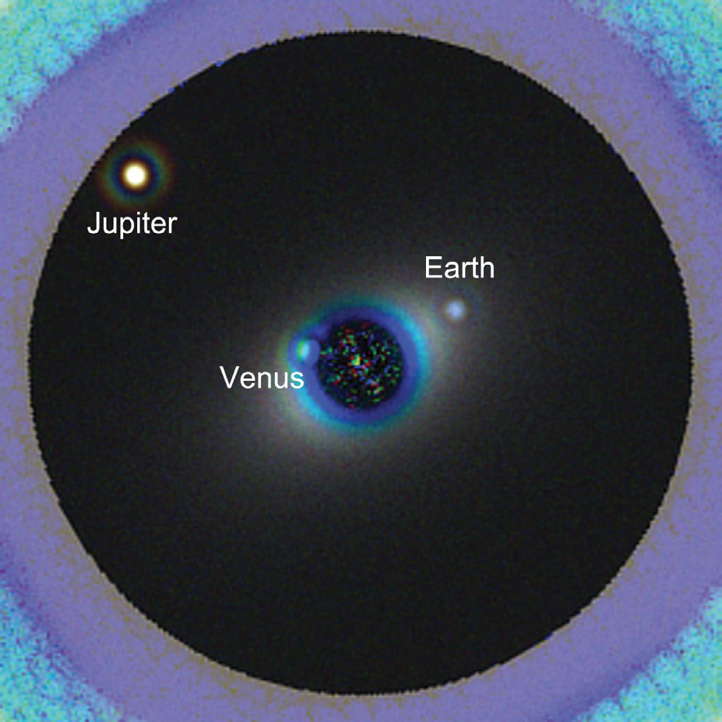
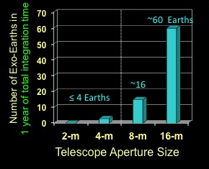
Exoplanets
Direct imaging & spectroscopy of exoEarths

Slide 11
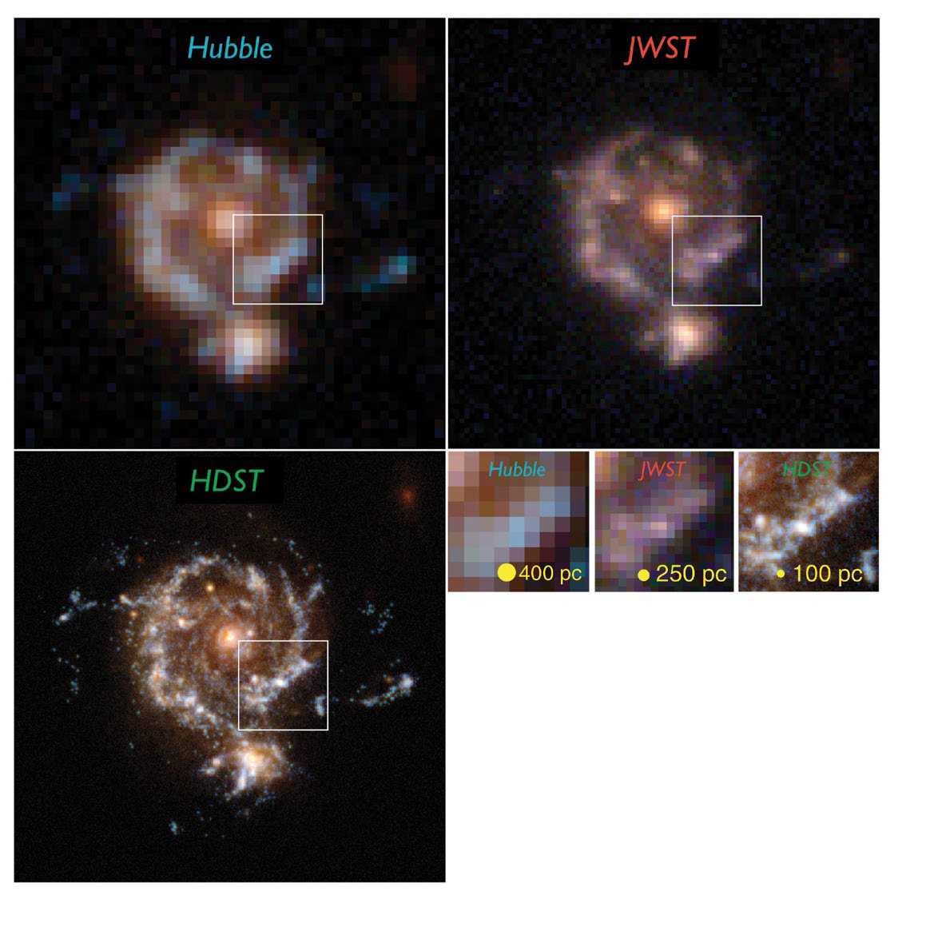
Other Science
Stars & stellar populations
  Protoplanetary disks & jets
  Stellar clusters
  Massive stars
Galaxy evolution

Slide 12
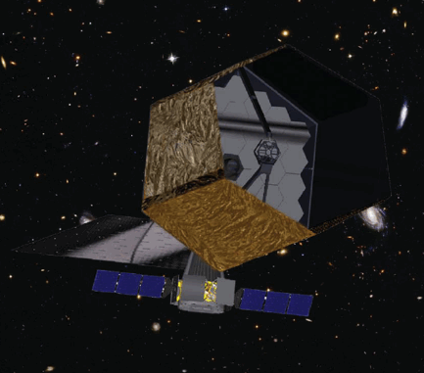
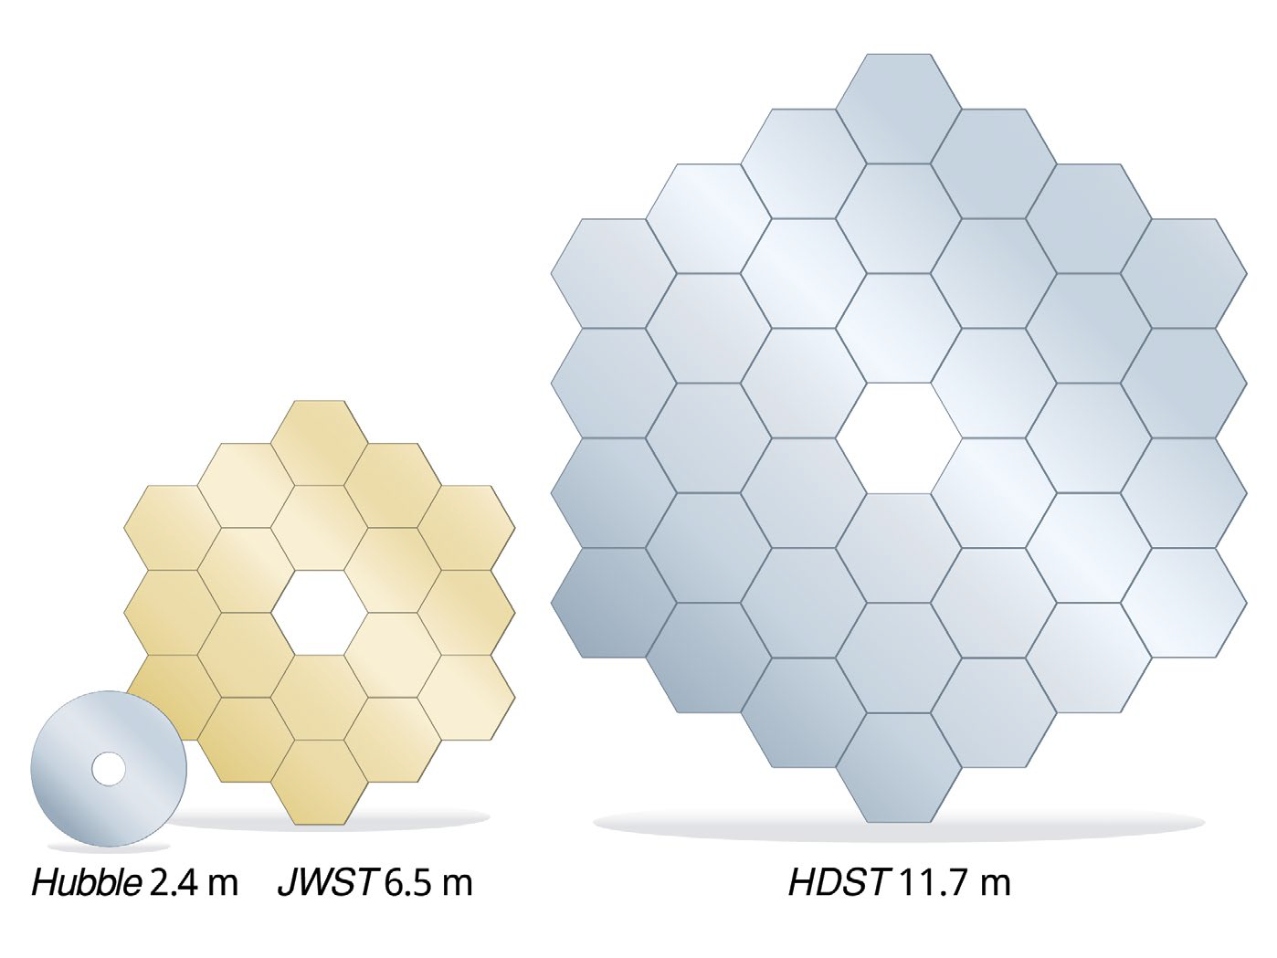
Technical Requirements
Telescope aperture > 10-12m
Coronograph or sunshade
  Contrast 10⁻¹⁰
Angular resolution < 10 mas
Range of spectroscopic capability
  R ~ 70-100 (for exoEarths)
  R ~ 20,000-100,000
Wavelength coverage from 91nm to 2µm
Ultra-low sky background

Slide 13
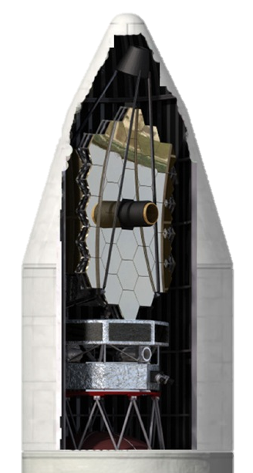
Conclusions
Timescale is long
  Concept is maturing
  Essential adopted in next US Decadal
  Launch not before 2030
ESA role?
  Appetite within ESA hierarchy for flagship involvement
  Along the lines of ESA contributions to HST & JWST
  Need to support US activities (in-hand)
  Need to be pro-active in developing interest within ESA
  Strongly support this initiative

